Slide 1
CYBER 731: Assignment 1
Communicating Really Bad News
Gunnar Yonker

Slide 2
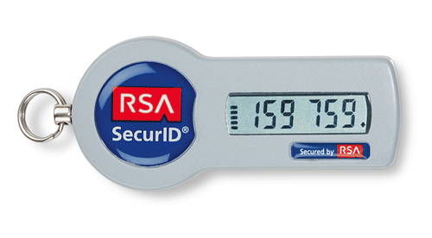
What Is The Problem?
RSA suffered a significant security breach
SecurID hardware tokens were stolen from the RSA Seed Warehouse
SecurID seeds are used to generate Two Factor Authentication Tokens
We use these key fobs as additional security when logging in
Potential to break this authentication with the stolen seeds if credentials are also cracked/stolen
The breach was a result of gained access through email phishing that introduced a malware called Poison Ivy to a PC
Leading to compromised credentials
SecurID seeds copied to a Rackspace server
The potential compromise of our assets and potential theft of classified information raises significant concern and requires immediate attention
The responsibility and underlying issue lies with RSA, there is nothing we can directly do to resolve the problem, just reduce the risk
https://i.stack.imgur.com/1Poh9.gif

Slide 3
Why Is It A Problem?
The breach puts our classified information at risk of being accessed and stolen by unauthorized individuals or groups
Using the RSA Seeds, attackers may be able to gain access to our system, bypassing the Two Factor Identification
The stolen information could be exploited by malicious actors to gain insight into our defense capabilities, weaknesses, and potentially disrupt or compromise systems
Loss of Competitive Advantage
Our contracts rely on the confidentiality and integrity of our technology, leading to potential financial repercussions
Regulatory and Legal Consequences
The breach may trigger legal and regulatory obligations to notify the public if our network or assets become compromised
Damage to Reputation and Trust
The breach raises concerns about our ability to safeguard sensitive information

Slide 4
What I Need Leadership To Do
Communicate with RSA
Establish a direct line of contact with RSA to understand the extent of the breach, their response efforts, and timeline for resolution along with any recommendations they propose to mitigate damage/risk
Assess the Impact
Conduct a comprehensive assessment of the potential impact of the breach on our classified information, defense systems, and contractual obligations.
Communicate Proactively
Develop a clear and consistent communication strategy to inform employees, customers, and partners about the breach, its potential impact, and steps being taken to address the situation. Focus on transparency and timely updates to ensure trust is maintained
Review Security Measures
Conduct an internal review of our security measures, policies, and procedures to identify any areas that require improvement or strengthening
Collaborate with internal IT teams to implement additional security controls if necessary
Develop an Incident Response Plan
Establish a comprehensive incident response plan that outline the step-by-step procedures to be followed in the event of a security breach or incident.
Enhance Employee Training and Awareness
Invest in robust cybersecurity awareness and training programs for all employees. Focus on re-evaluating training and awareness of social engineering techniques such as email phishing attempts

Slide 5
References
Greenberg, A. (2021, May 20). The full story of the stunning RSA hack can finally be told. Wired. https://www.wired.com/story/the-full-story-of-the-stunning-rsa-hack-can-finally-be-told/

